Slide 1
Rochester Area Manufacturing Opportunities
Presented by:
Ferah Roman & Adrian Hale

Slide 2
McAlpin Industries
McAlpin Industries is a precision metal working company that provides services to many sectors including telecommunications, computer, office equipment, heavy equipment, warehouse management, and automotive.
Founded in 1964 by Frank McAlpin and Ralph Derleth. In 1972 they moved to 255 Hollenbeck street (present day location). In 2016 they opened up a 60,000 sq. ft. facility in Walworth NY.
Products manufactured include a Steel Evaporate Canister Bracket used in HVAC systems for automobiles, an Adjustable Table, and a Mechanical Assembly for Telecommunications equipment.

Slide 3
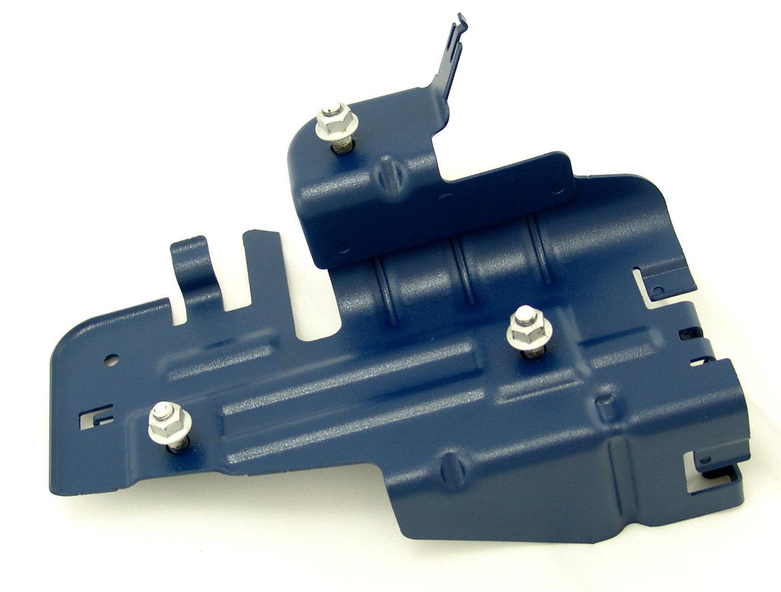
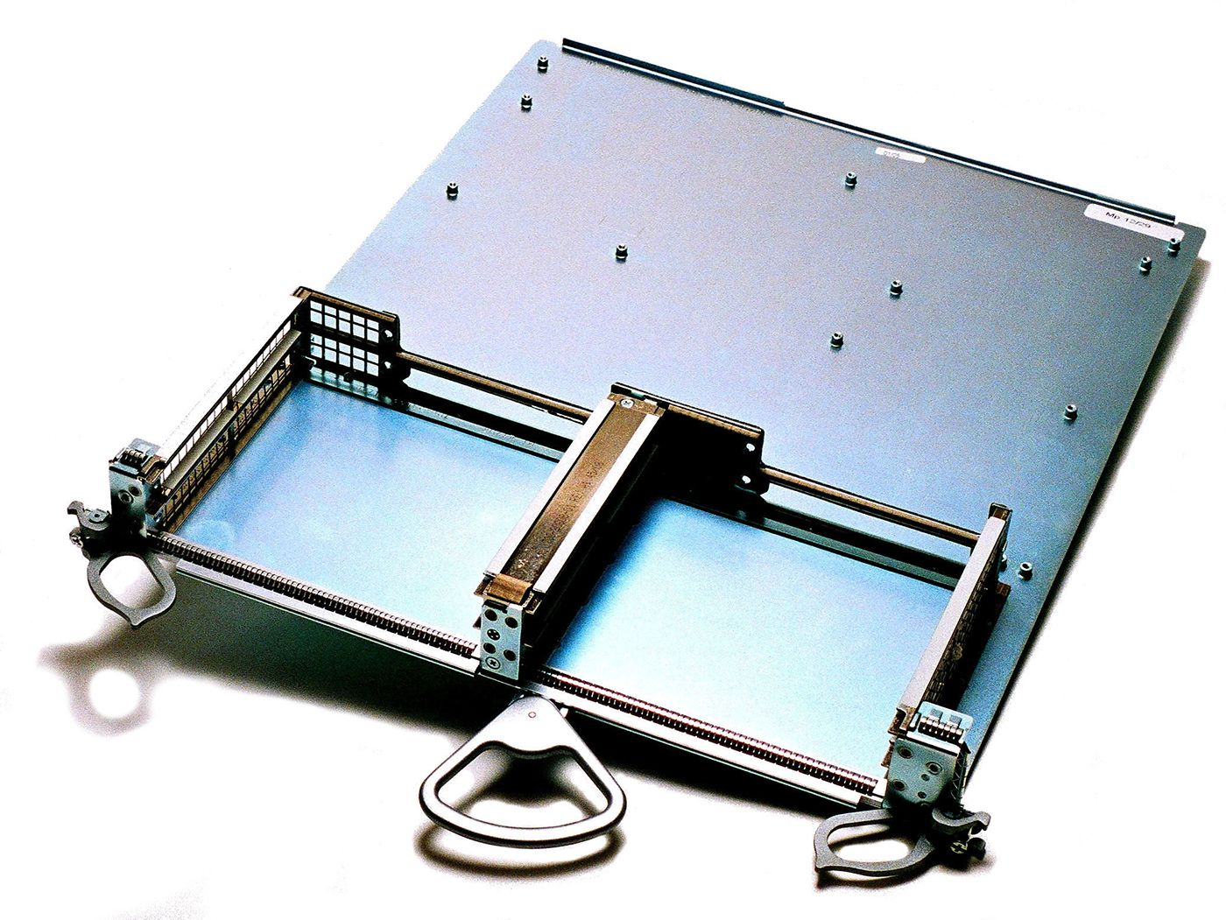
McAlpin Industries Products
Mechanical Assembly for
Telecomm
Equipment
Steel Evaporative Canister Bracket

Slide 4
McAlpin Industries In Action

Slide 5
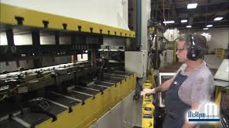
Jobs at McAlpin Industries
Robotic Weld Cell Operators
Maintenance Mechanic Technician
Production Line Operator/Assembler

Slide 6
LiDestri Foods
LiDestri Foods is a private label and contract manufacturer of foods with local facilities in Fairport and Rochester.
The company was founded in 1975 as Cantisano Foods by Ralph Cantisano. The Cantisano family. They had previously owned and sold the Ragu Packaging Company. By 1976, LiDestri was being managed by its current owner Giovanni LiDestri who decided to start manufacturing pasta sauce.
Today LiDestri Co-Packs and creates Soups, Pasta Sauces, BBQ Sauce, Ketchup, and many other products. Notable customers include Newman’s Own Pasta Sauce and some types of Barilla Pasta Sauce.

Slide 7
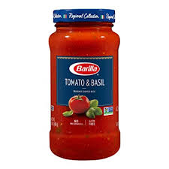
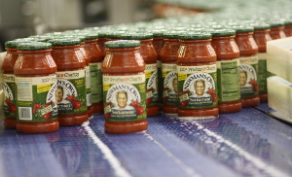
LiDestri Foods Products
Newman’s Own Sauce
Barilla Pasta Sauce

Slide 8
LiDestri in Action

Slide 9
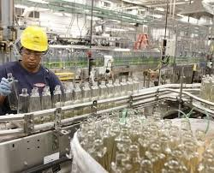
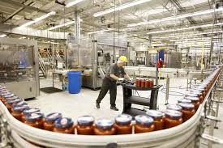
Jobs at LiDestri Foods
Forklift Operator
Machine Operator
Automation Technician

Slide 10
Century Mold
Century Mold is a plastics manufacturing company headquartered in Rochester, NY that makes parts for the automotive industry.
They make parts used in Engine Cooling, Engine &Transmission, HVAC/Climate Control, and many other systems in automobiles.
According to Bloomberg, they were founded in 1979.
They also have facilities in Michigan, Ohio, Tennessee, and Mexico.

Slide 11
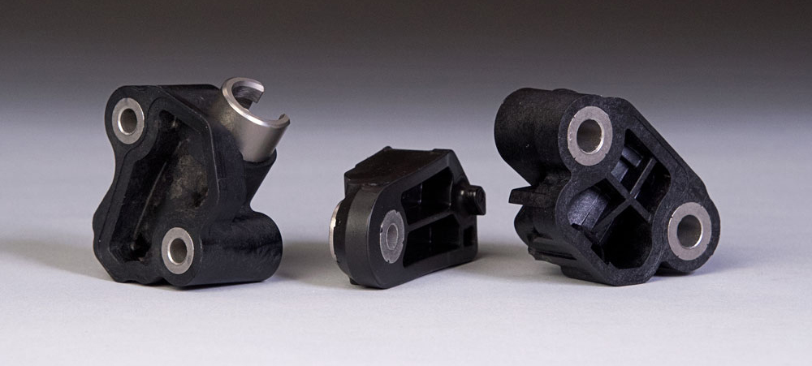
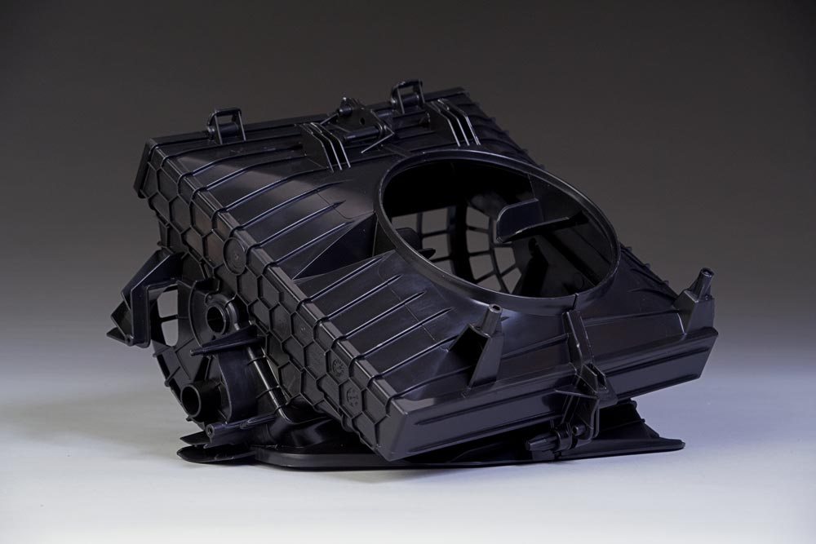
Century Mold Products
Engine Cooling Device
Engine Transmission Parts
HVAC/Climate Control Device

Slide 12
Century Mold in Action

Slide 13
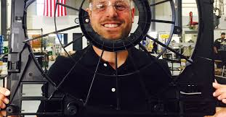
Jobs At Century Mold
Maintenance Technician
Machine Operator
Mold Repair Technician
Mold Maker

Slide 14
Alliance Precision Plastics
Alliance Precision Plastics is a full service injecting molding company headquartered in Rochester, NY.
They offer mold design, tooling, injection molding, and full service assembly to their clients.
According to their website, they were founded in 1953 in Rochester, New York. They started as a tool and die company and made stamping dies, trim dies, and die-castings.

Slide 15
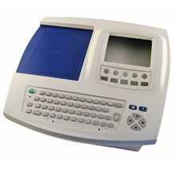
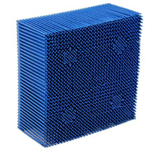
Alliance Precision Plastics Services
According to their website, they offer injection molding to a variety of industries including Healthcare, Business Machines, Industrial Products, and Appliances.
One of the Industrial Products
Business Machine

Slide 16
Alliance Precision Plastics In Action

Slide 17
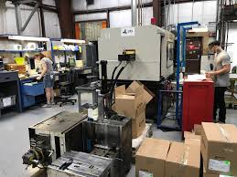
Jobs At Alliance Precision Plastics
Machine Operator
Assembly Operator
Production Material Handler
Set Up/Process Technician

Slide 18
Forteq
Forteq is a precision plastic technology company. They manufacture parts used in medical devices, printers, and cars.
The company has locations all over the world from Rochester to Switzerland.

Slide 19
Forteq Products
Healthcare- Drug delivery and diagnostic devices.
Automotive- Transmission solutions for diesel and petrol engines.
Office Equipment and Consumer Electronics- Transmission Solutions.
Healthcare- Drug Delivery Device
Office Equipment Transmission Solution
Automotive- Transmission Solution

Slide 20
Forteq in Action

Slide 21
Jobs At Forteq
Currently nothing posted but you would likely find similar roles to the other companies.

Slide 22
Questions???

